Slide 1
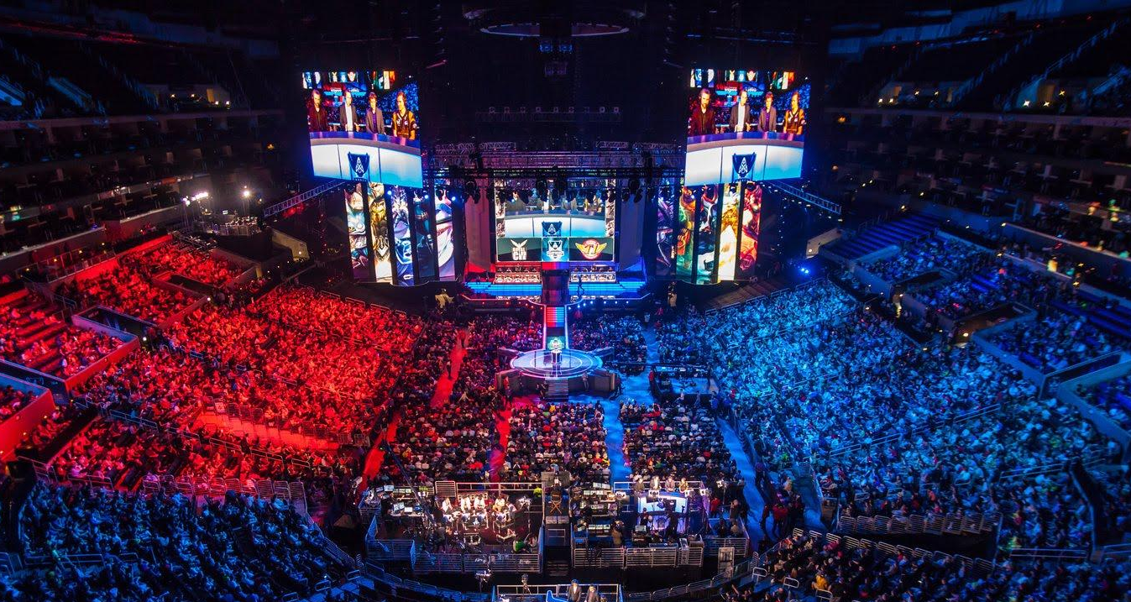
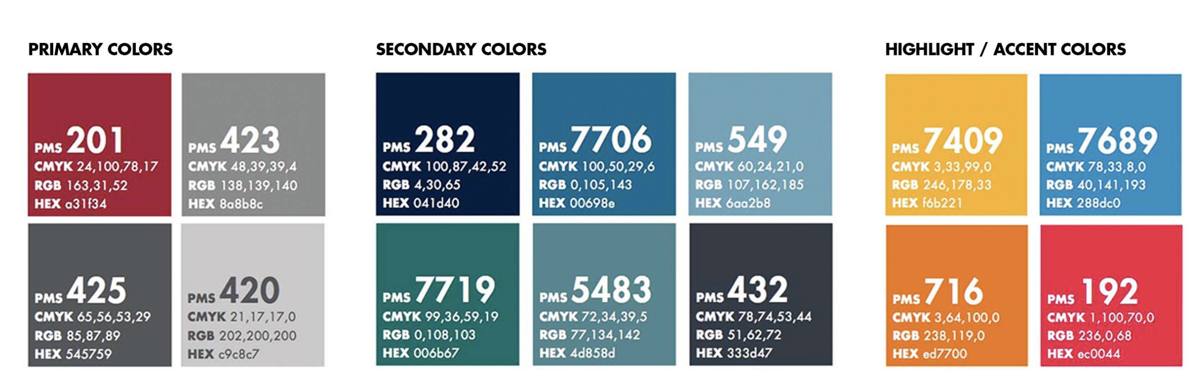

Prediction and Recommendations
for Leagues of Legends Tournament

Slide 2

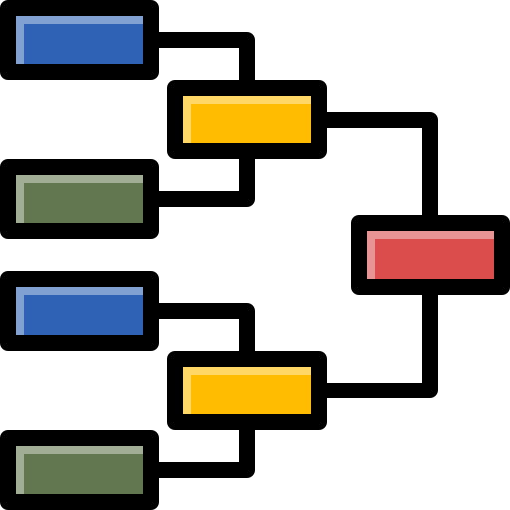
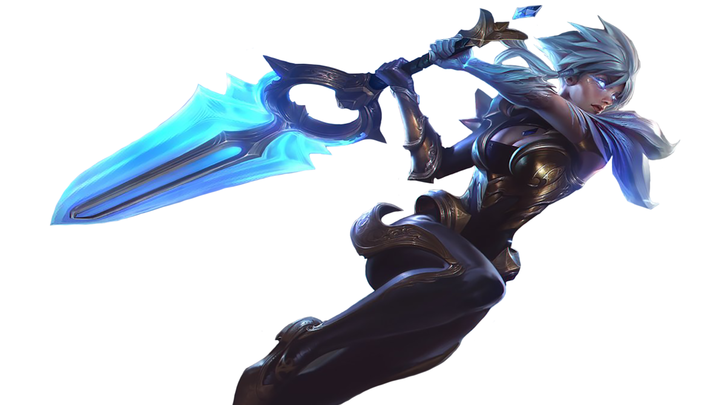

League of Legends
2 sides
5 positions each side
150 champion options
Objective: destroy enemy’s base
~4,300 matches

Slide 3

$9.0M Prize pool
Motivation
League of Legends is widely considered one of the most popular eSports games
More than 4,000 tournament matches each year
Prize Pool
$M
~4,300 matches
200% increase in 4 years
In this project, we want to create models that help
Understand factors behind winning games
Plan champion selections for pro-players
Apply optimization-based ML techniques on a difficult problem to test methods empirically

Slide 4
Data / Features Engineering
Pro-player matches from 2017-2020
500 Features
Match metadata (league, patch, year, etc.)
Player past statistics (avg winrate, avg KDA, etc.)
Champion past statistics (avg winrate, avg selected-rate, etc.)
Dependent variable : win / loss
Due to game updates, we hypothesized two data splits
Train: Y2018-2019 / Test: Y2020
Goal: predict for the future years
Train: 1st half / Test: 2nd half of the year
Goal: predict for the end of the season
All professional ranked matches 2017-2020.
Matches contained information on 5 players for each team
Match metadata (date, time, league, game update number, etc.)
Data transformation performed for preferred modelling format:
1 match is a single row
Team A vs Team B, features for both teams
Dependent variable: result for Team A (win/loss)
Developed statistics of In-game performance for each player in the past 6 months, year:
Average KDA ratio, Average gold, Player win rate, etc.
Developed statistics of In-game performance for each champion in the past 6 months, year:
Champion win rate, Playrate, etc.
Champion Selection features for each player:
Top lane choice, enemy top lane choice, etc.

Slide 5
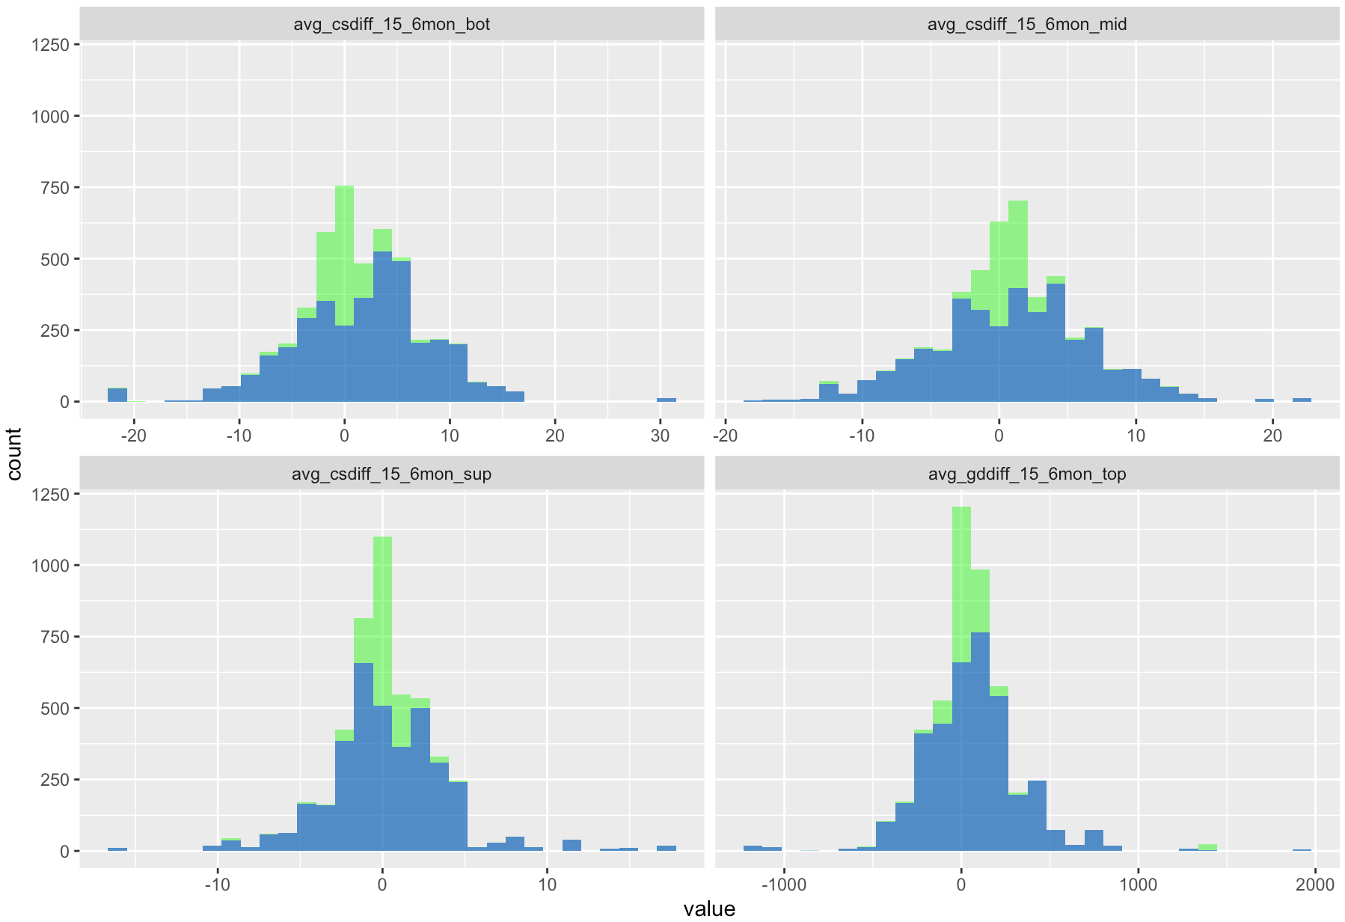
Optimal Imputation
25% missing values with some columns at ~40% missing values
Optimal KNN Imputation was applied
Original Values
Imputed Values

Slide 6
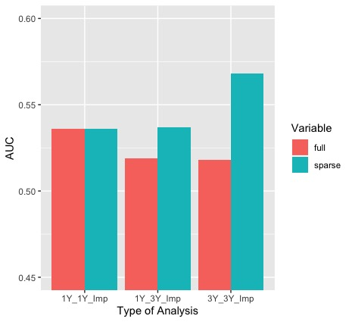
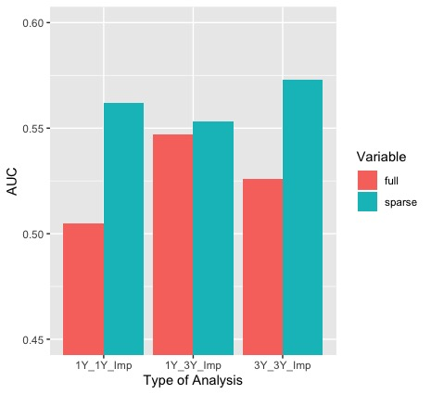
Full Dataset (500 Features)
Results – AUC Analysis
Sparse Dataset (12 -16 Features)
CART
OCT

Slide 7
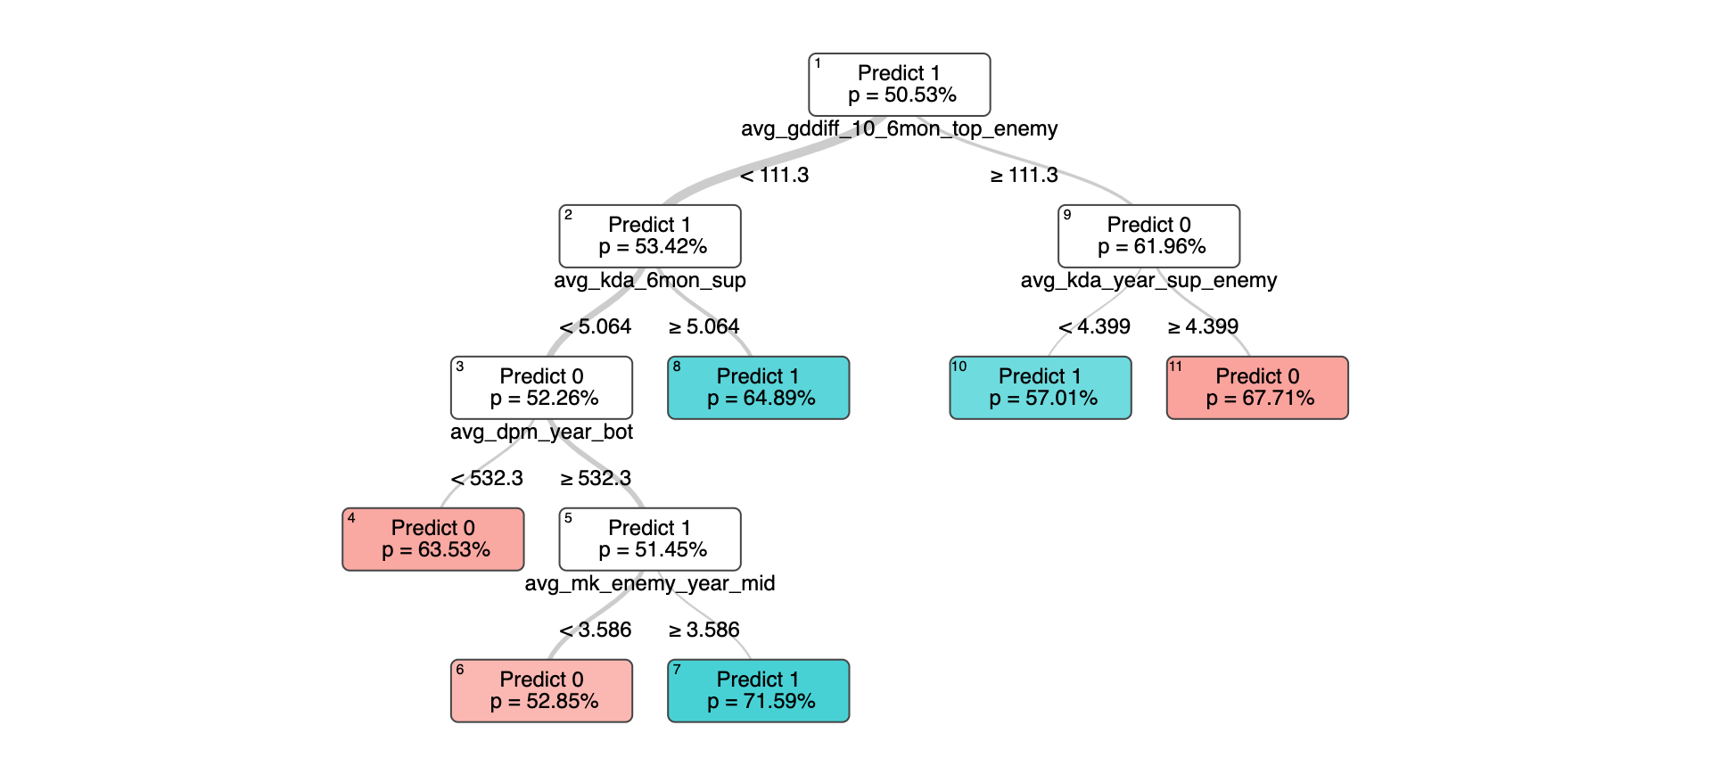
Results - OCT
Main Factors
Gold different at Top-lane
Performance of the Support and Bottom-lane
No. of crucial monsters stole from enemy’s area

Slide 8
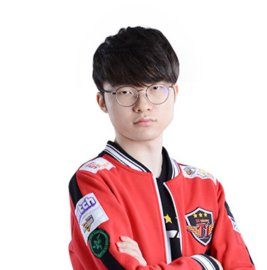

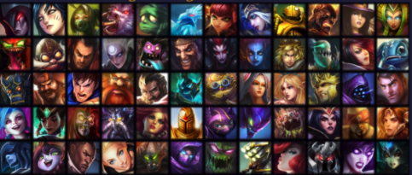




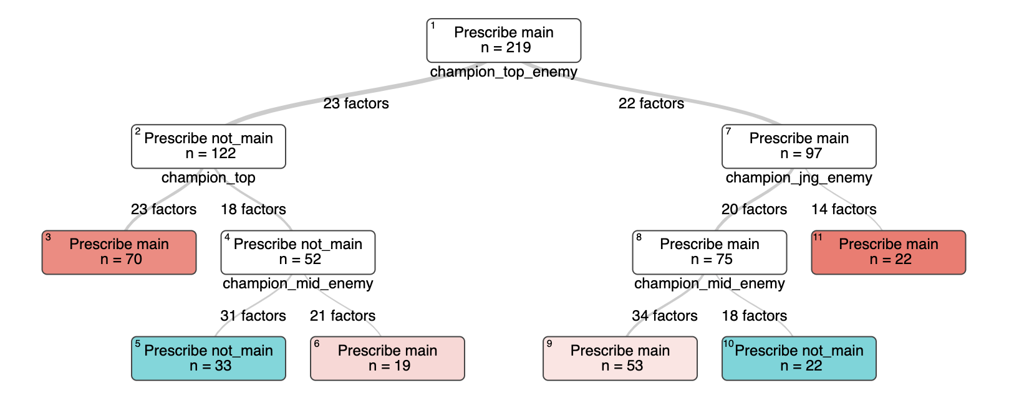

Prescriptive – Strategize Mid-lane’s Champion Selection
Option 1: Main Champions
Option 2: Other Champions
Results
KDA (Kills + Assists / Deaths)
Original: 7.0
Predicted: 11.9
70%
Decision Factors
Our Top-lane
Enemy Jungle and Mid-lane

Slide 9
Conclusions
Applied Sparsity and Robustness through optimal feature selection
7% increase in AUC
Utilized Interpretable models to inform team League of Legends training strategy
Improve support & bottom lane player performance
Optimized champion selection decision through optimal prescriptive trees
70% improvement to player KDA

Slide 10
Thank You!

Slide 11
Results – Win/loss Prediction
Full Data
(500 Features):
Sparse Data
(10-16 Features):
 | 3 Years Data (3 Yr imputed) |  | 1 Year Data (3 Yr imputed) |  | 1 Year Data (1 Yr imputed) |  | 3 Years Data (3 Yr imputed) |  | 1 Year Data (3 Yr imputed) |  | 1 Year Data (1 Yr imputed)
 | AUC | Acc. | AUC | Acc. | AUC | Acc. | AUC | Acc. | AUC | Acc. | AUC | Acc.
Logistic/ SVM |  |  |  |  |  |  | 0.594 | 0.573 | 0.603 | 0.588 | 0.602 | 0.572
CART | 0.518 | 0.517 | 0.519 | 0.513 | 0.536 | 0.535 | 0.568 | 0.544 | 0.537 | 0.536 | 0.536 | 0.535
RF | 0.624 | 0.591 | 0.621 | 0.583 | 0.623 | 0.584 | 0.605 | 0.578 | 0.592 | 0.568 | 0.599 | 0.574
OCT | 0.526 | 0.515 | 0.547 | 0.531 | 0.505 | 0.505 | 0.573 | 0.554 | 0.553 | 0.549 | 0.562 | 0.548

Slide 12
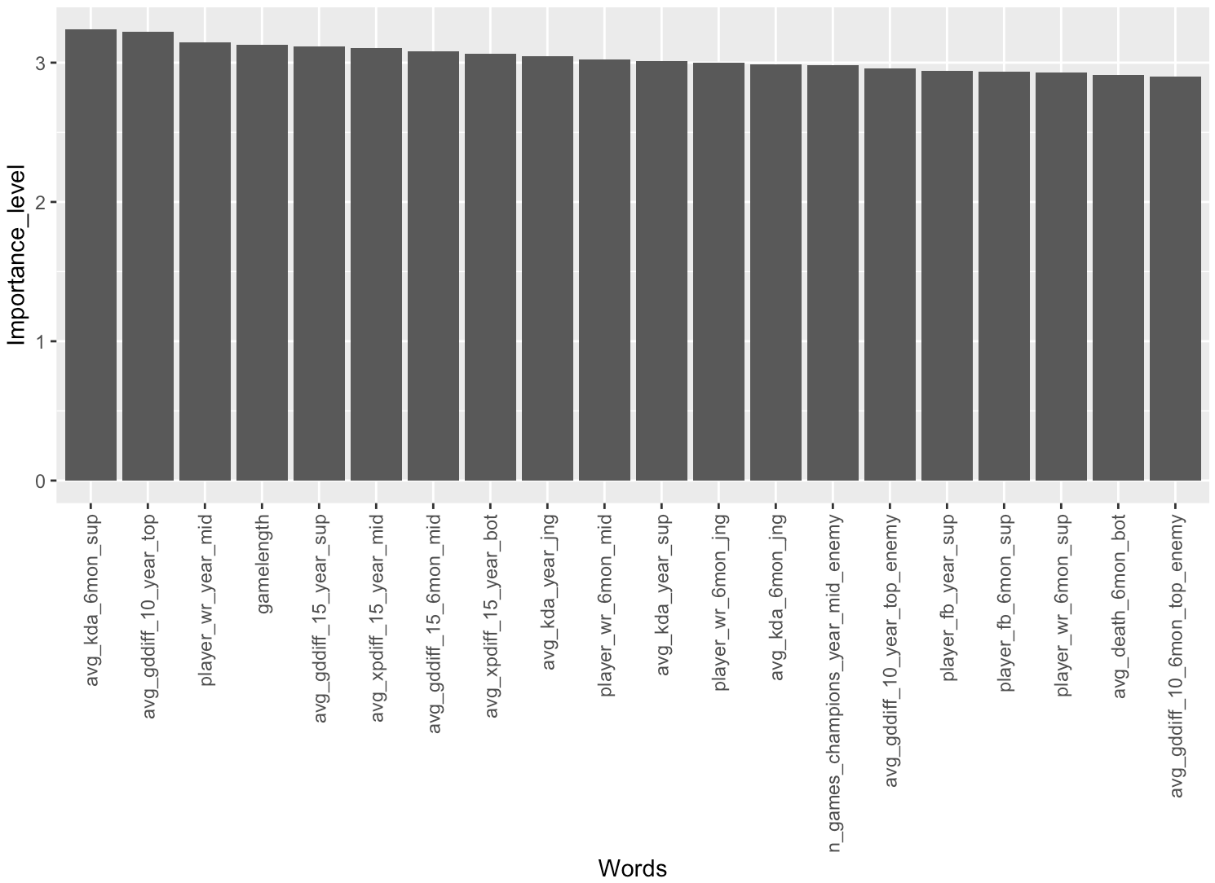
Feature Importance

Slide 13
Conclusions
Optimal feature selection applies effective robustness and sparsity to large datasets to improve modelling results
7% AUC increase
Interpretable prediction models provide Esports managers team training strategies
Focus on support & bottom lane player performance
Optimal prescription trees lead to optimized champion selection decisions
Improve player KDA by 70%

Slide 14
Conclusions
Applied sparsity and robustness through optimal feature selection
7% increase in AUC
Utilized interpretable models to inform team training strategies
Focus more on support & bottom lane players performance
Optimized champion selection through optimal prescriptive trees
70% Improvement to player KDA

